Slide 1

Capstone Project
Travel Approval App
Name- Jatin Balani
Lms Id- MGSA_531

Slide 2
Contents:
Introduction
Module-1
Module-2
Module-3

Slide 3
Introduction:
The definition of CRM is customer relationship management. In a nutshell, CRM lets you store and manage prospect and customer information, like contact info, accounts, leads, and sales opportunities, in one central location. You’ll discover that it’s not just a fancy contact list.
As a result, CRM can help you:
Increase leads
Close more deals, faster
Drive customer loyalty and satisfaction

Slide 4
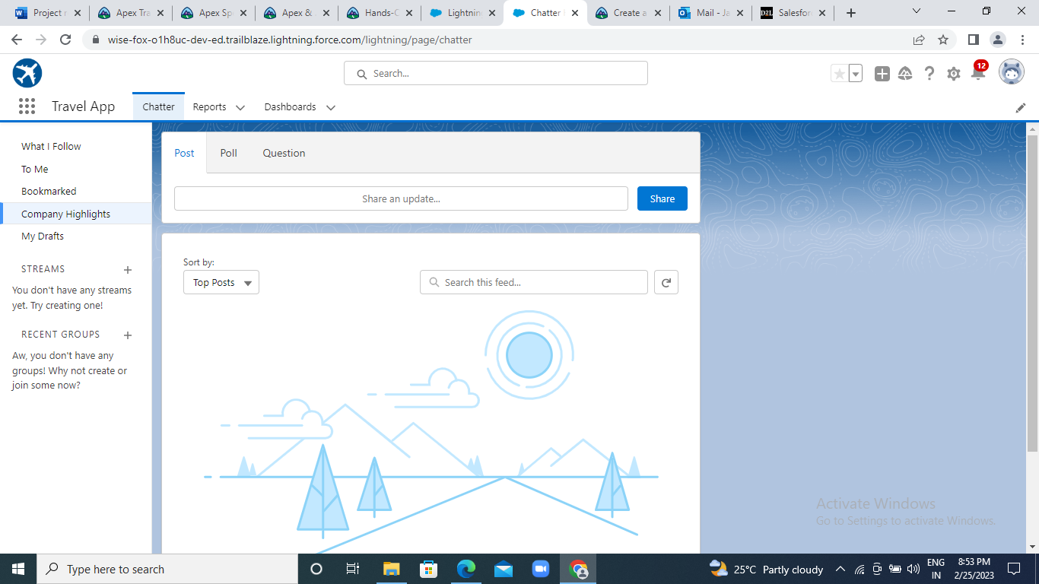
Module-1
Exercise-1:

Slide 5
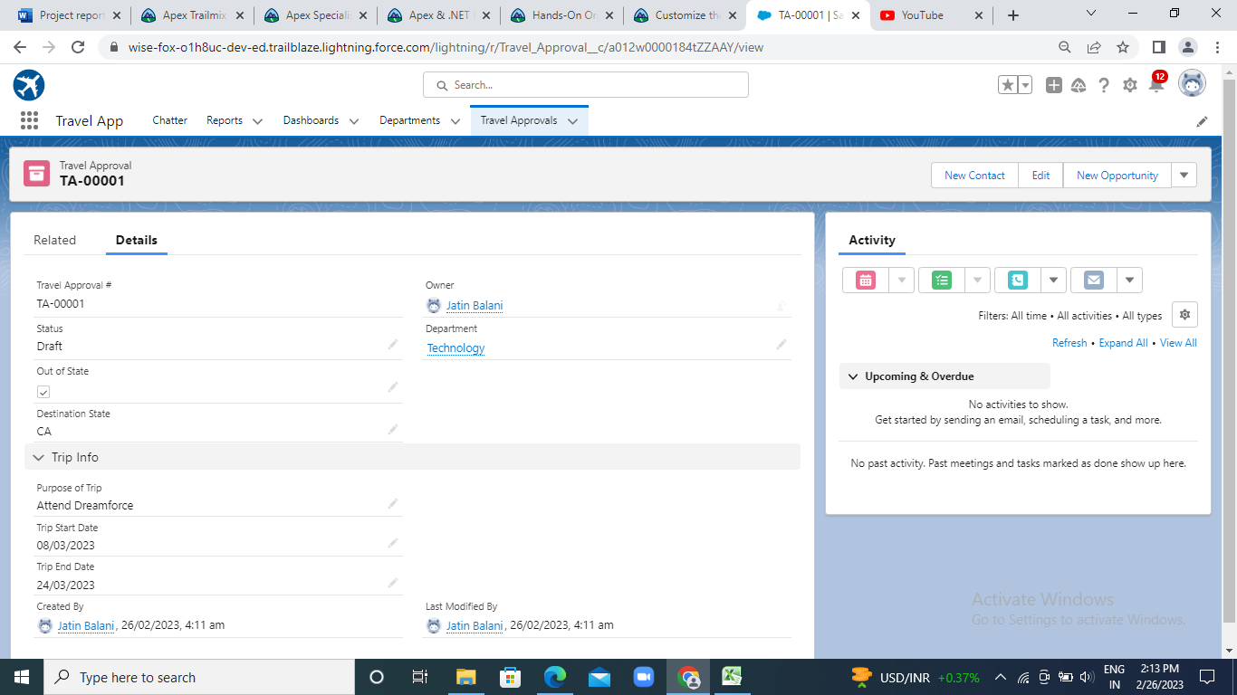

Slide 6
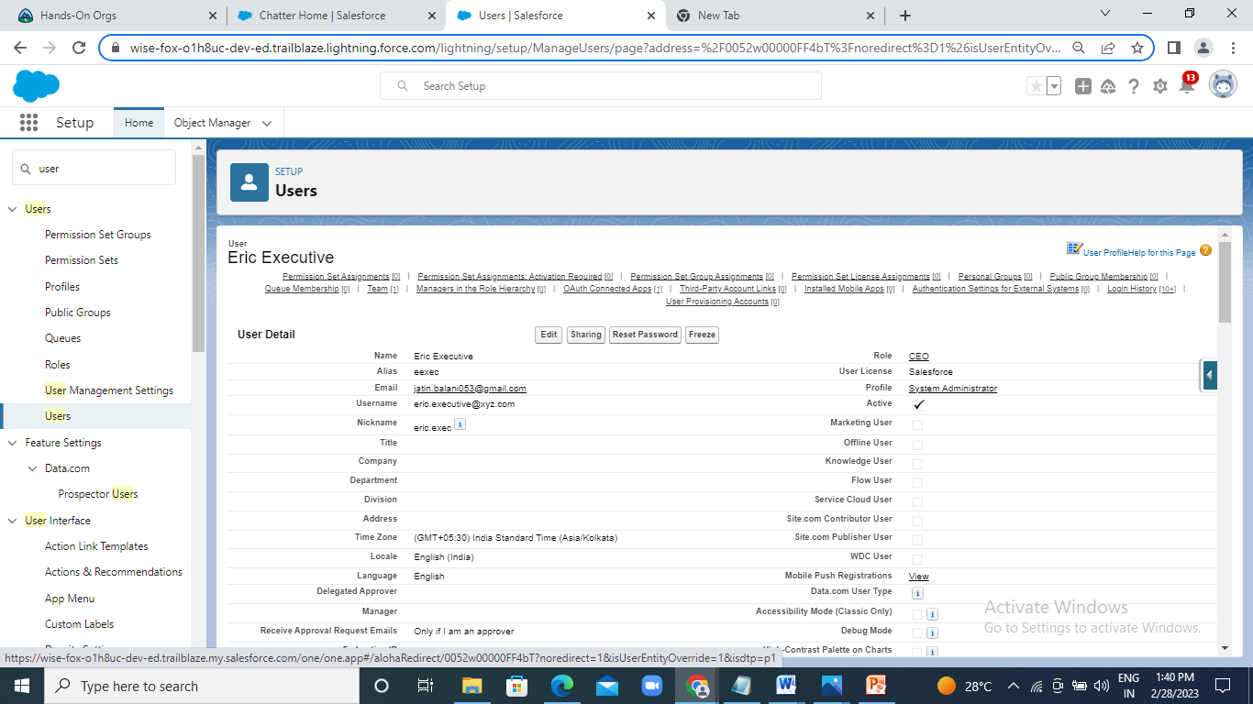
Exercise- 2:

Slide 7
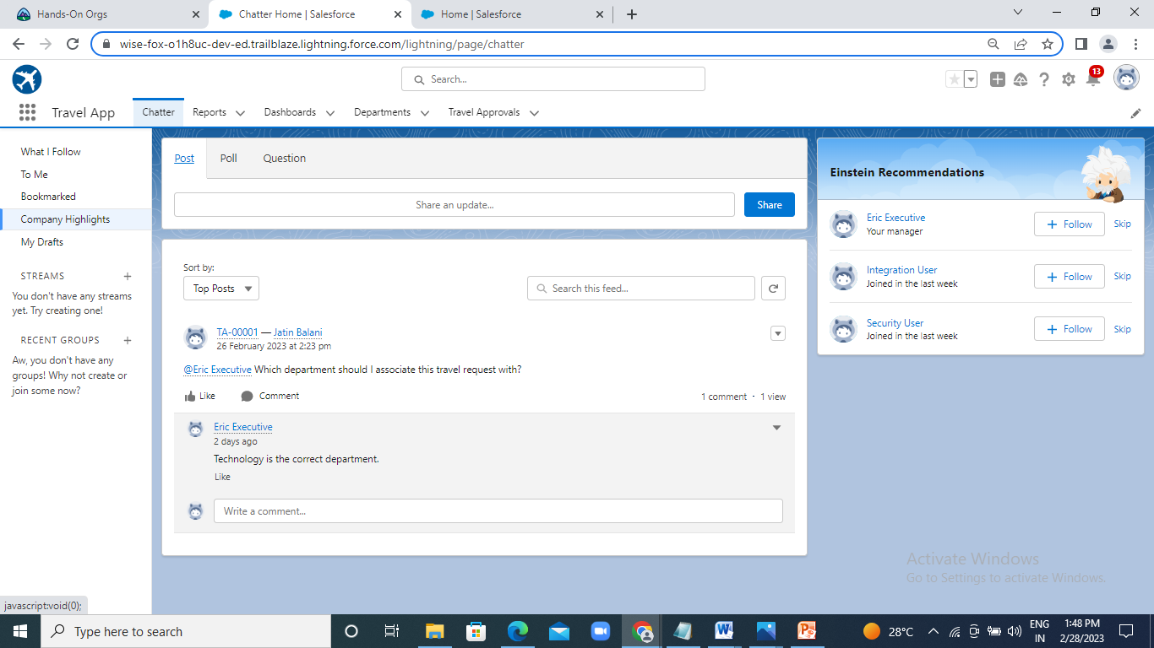
:Test Chatter:

Slide 8
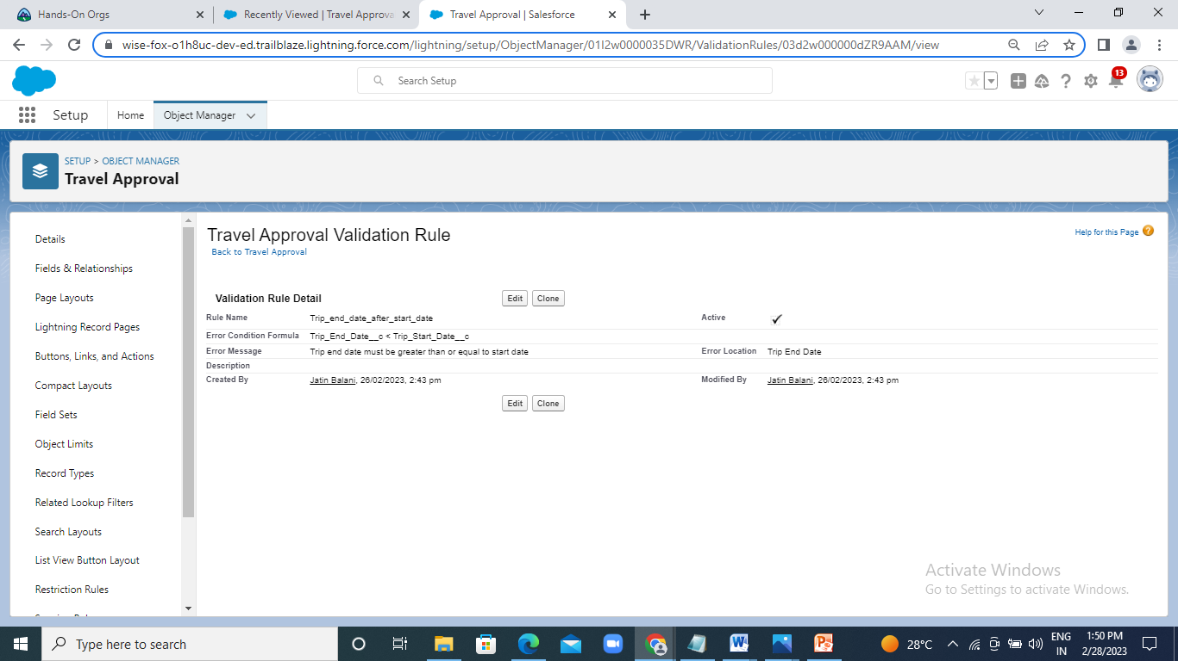
Module-2:
Exercise-1:

Slide 9
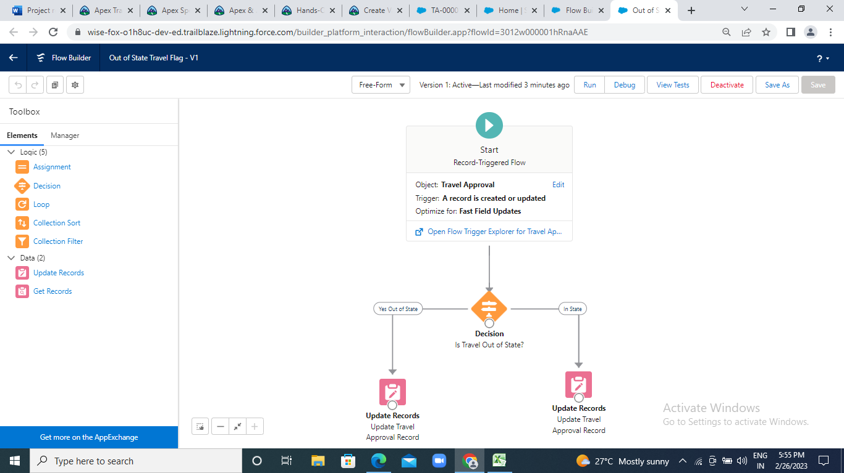

Slide 10
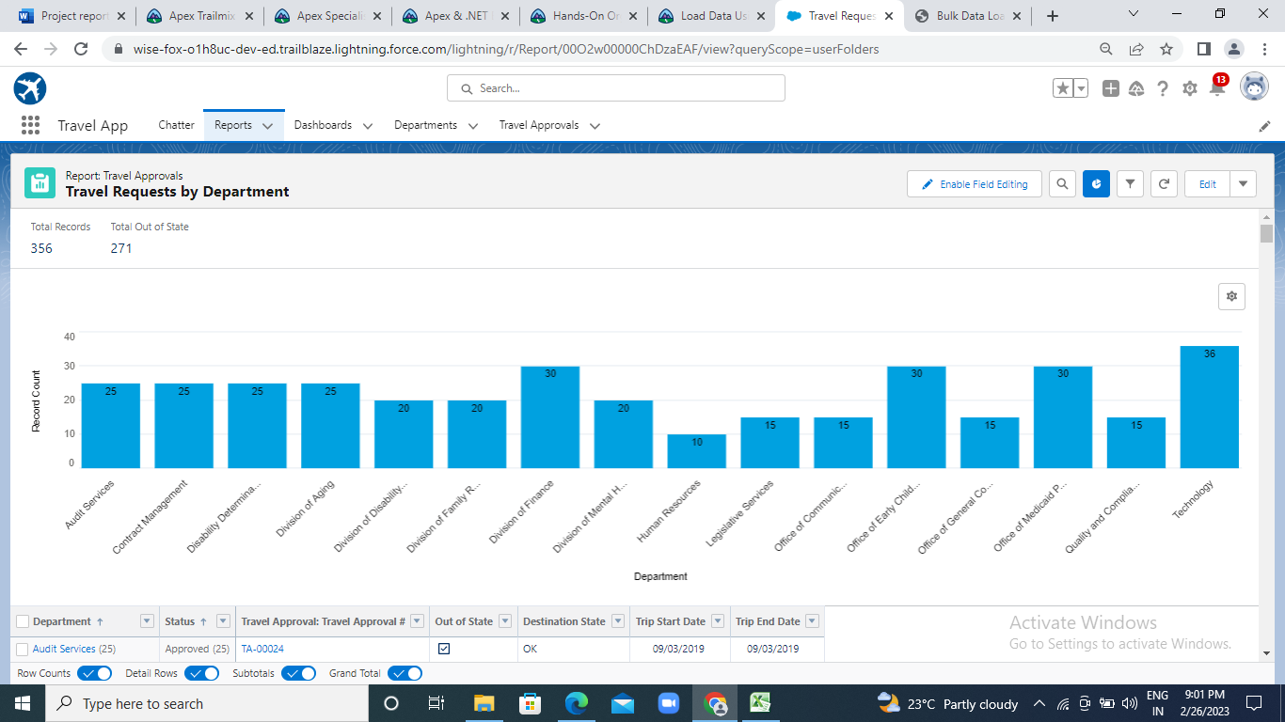
Exercise-2:

Slide 11
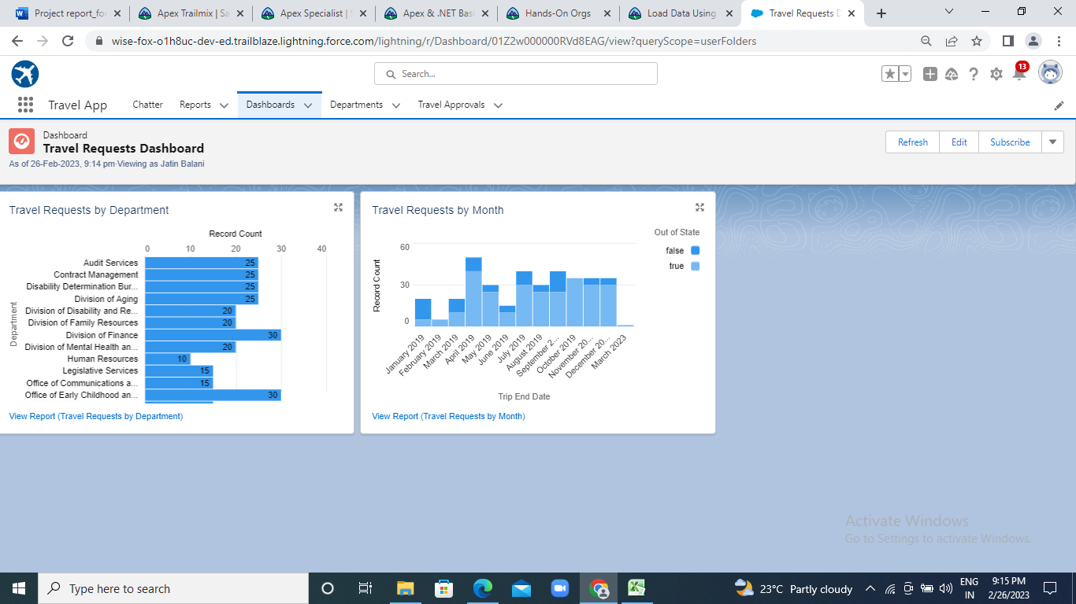

Slide 12
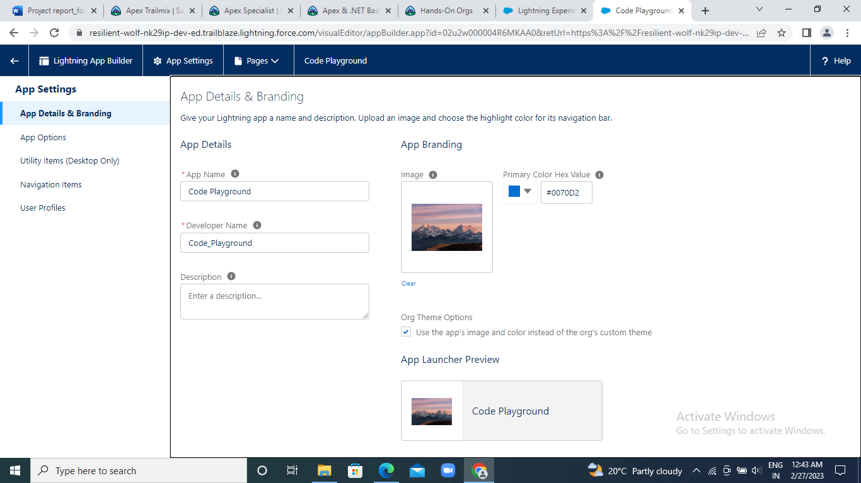
Module-3:
Exercise-1:

Slide 13
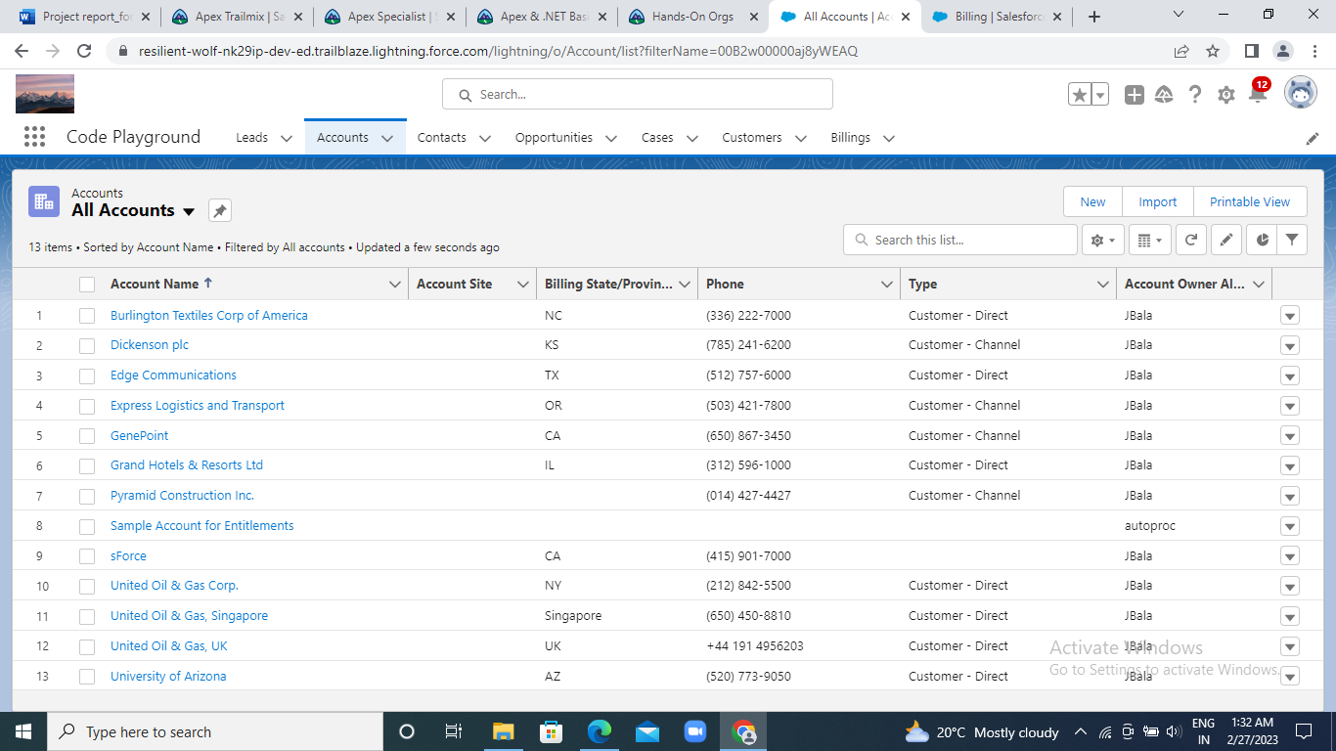
Test the App:

Slide 14
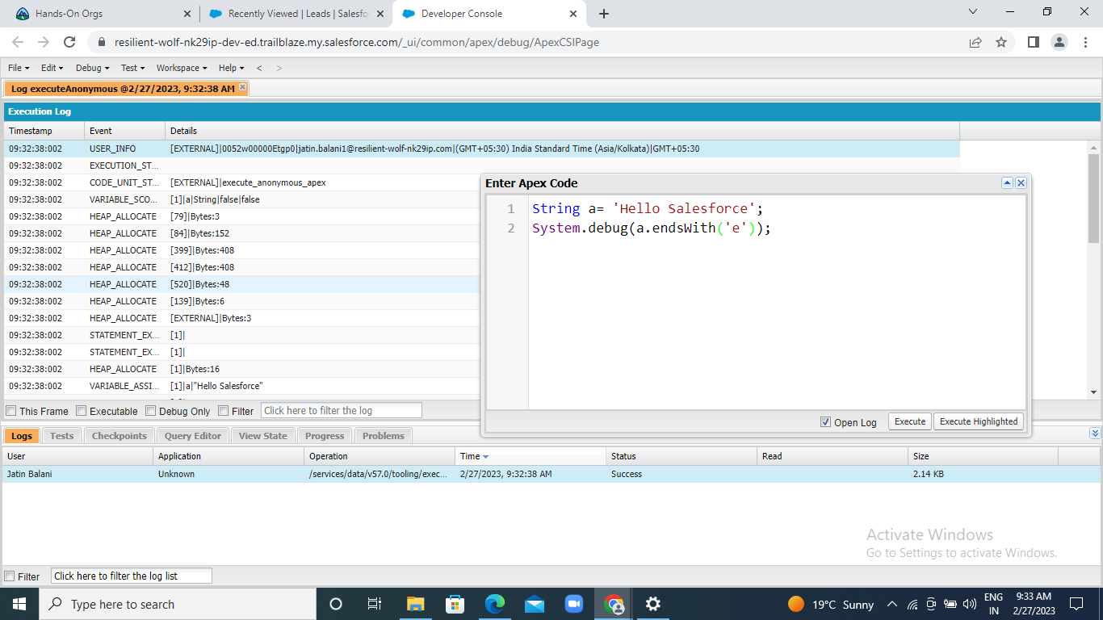
Exercise-2 : Define a string variable and use method ‘endsWith’ to display the outpuT

Slide 15
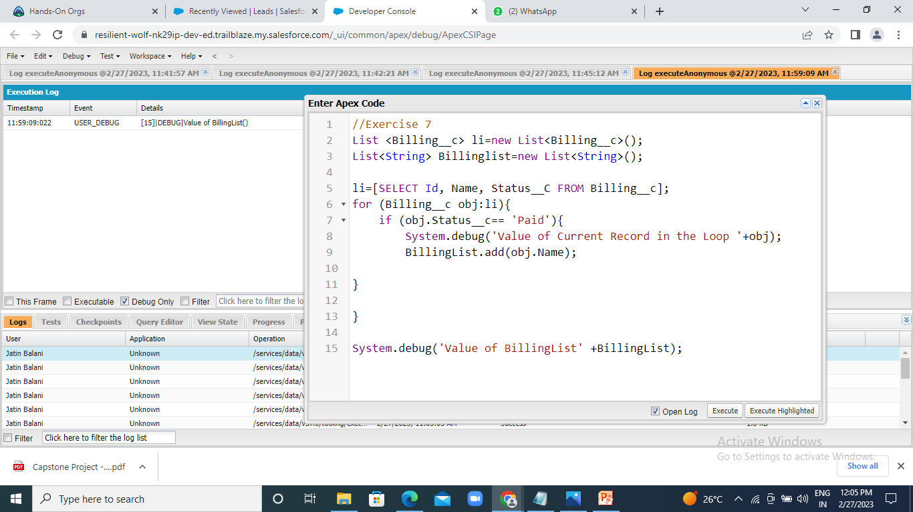
Exercise-7:

Slide 16
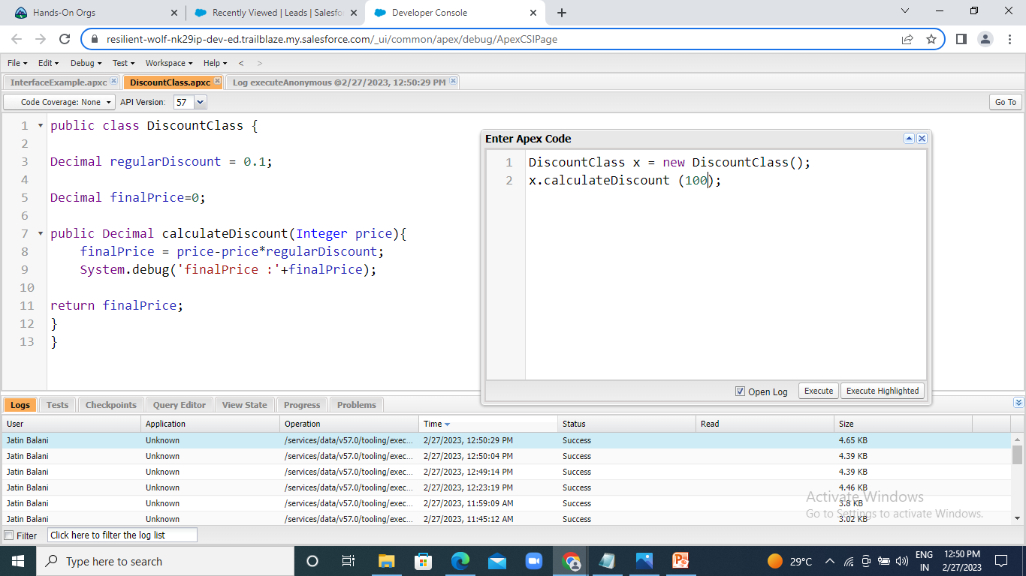
Exercise-8:

Slide 17
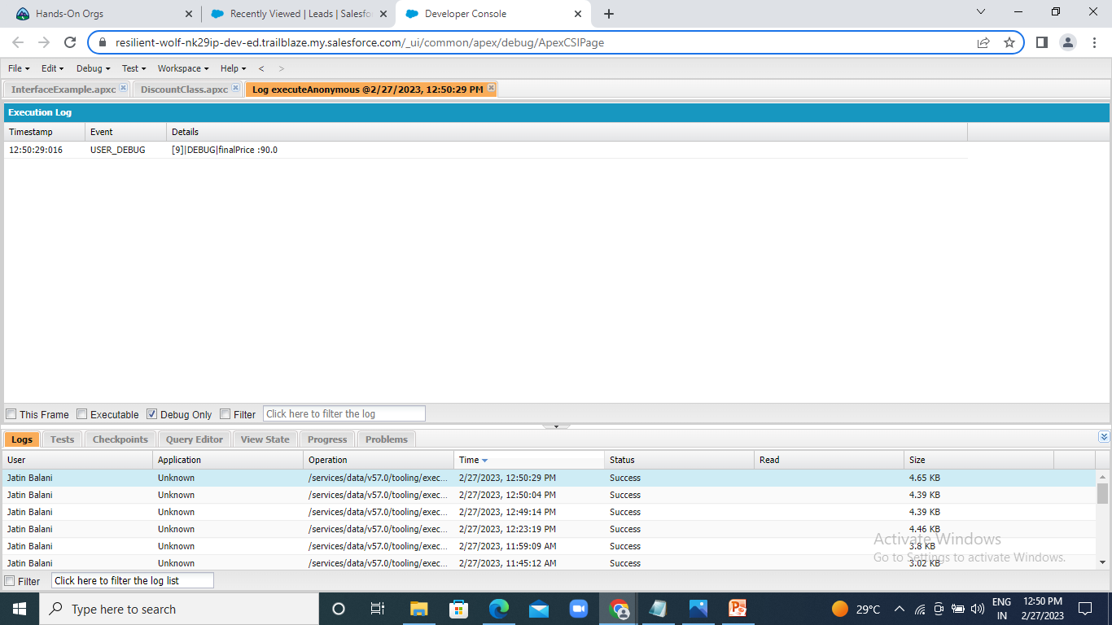
Output:

Slide 18
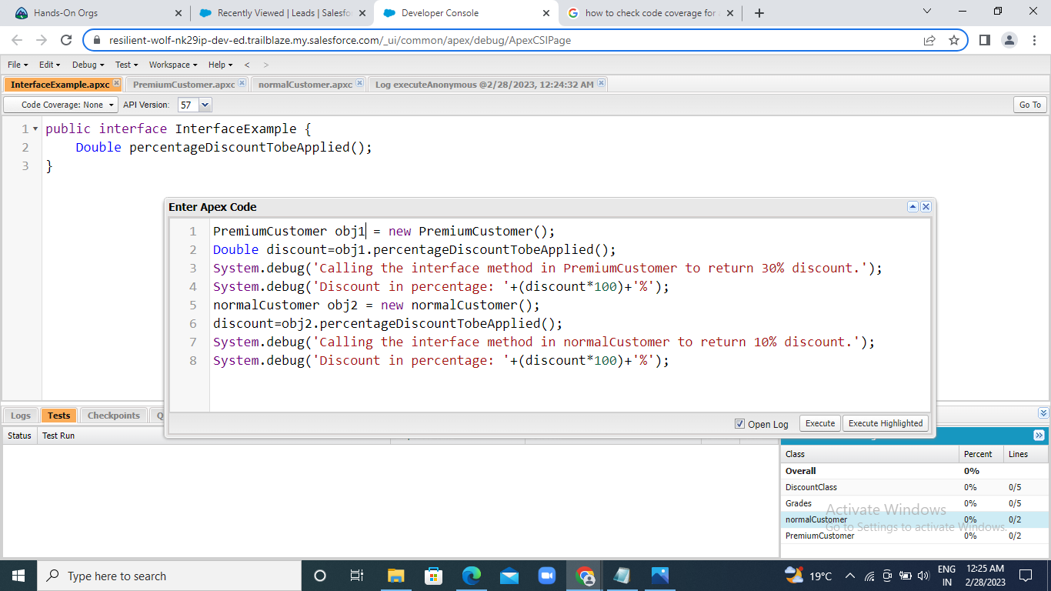
Exercise-9:

Slide 19
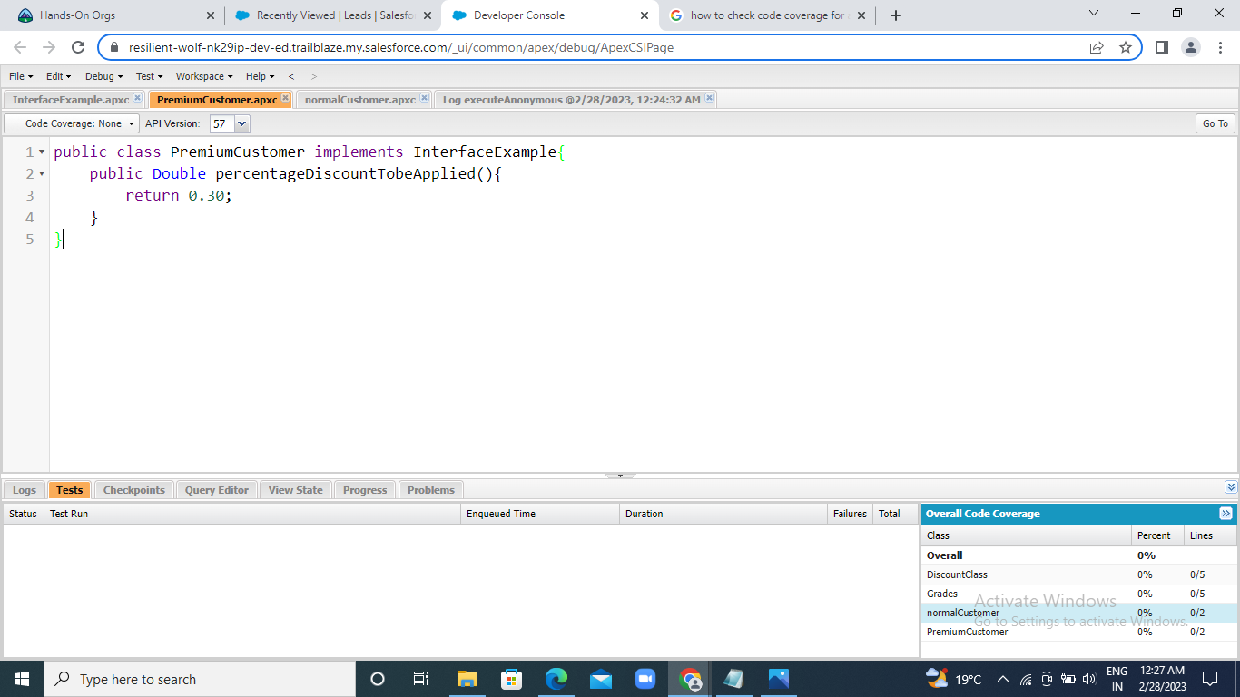
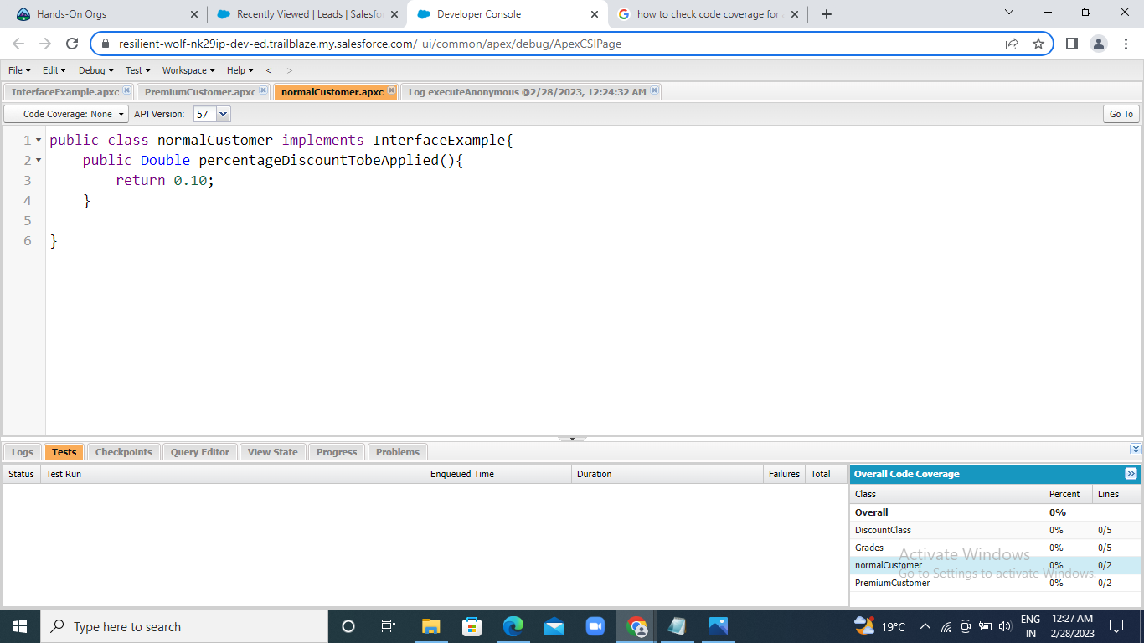

Slide 20
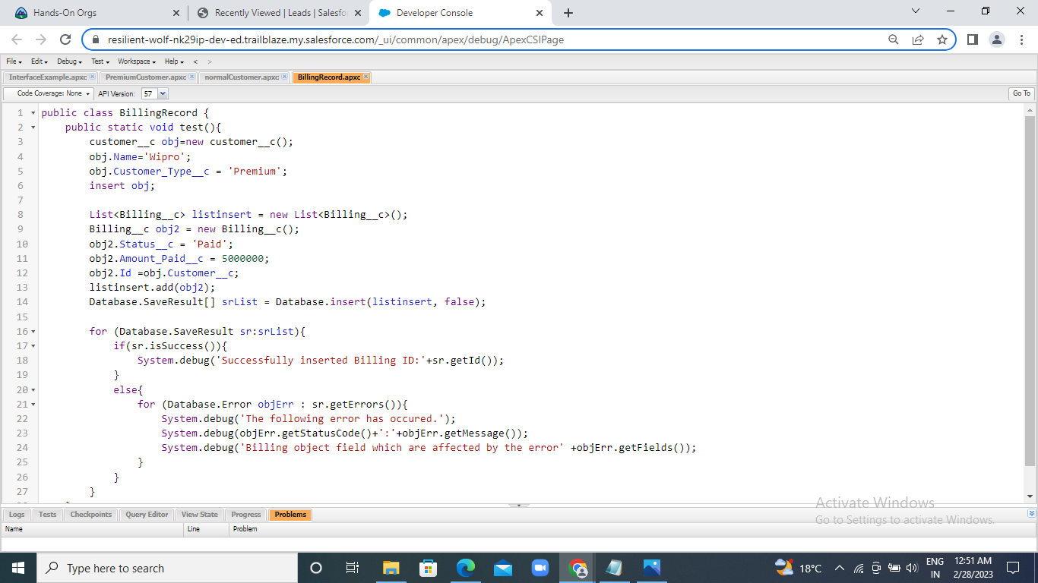
Exercise-10:

Slide 21
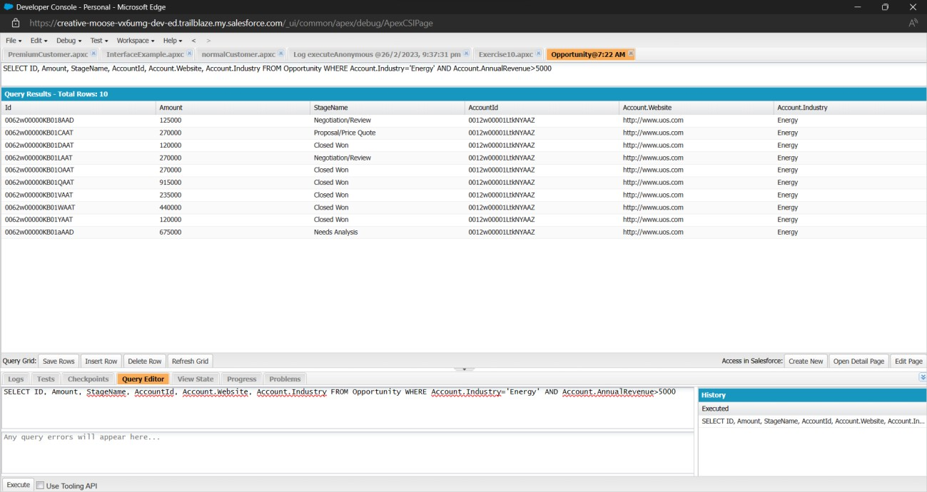
Exercise-11:

Slide 22
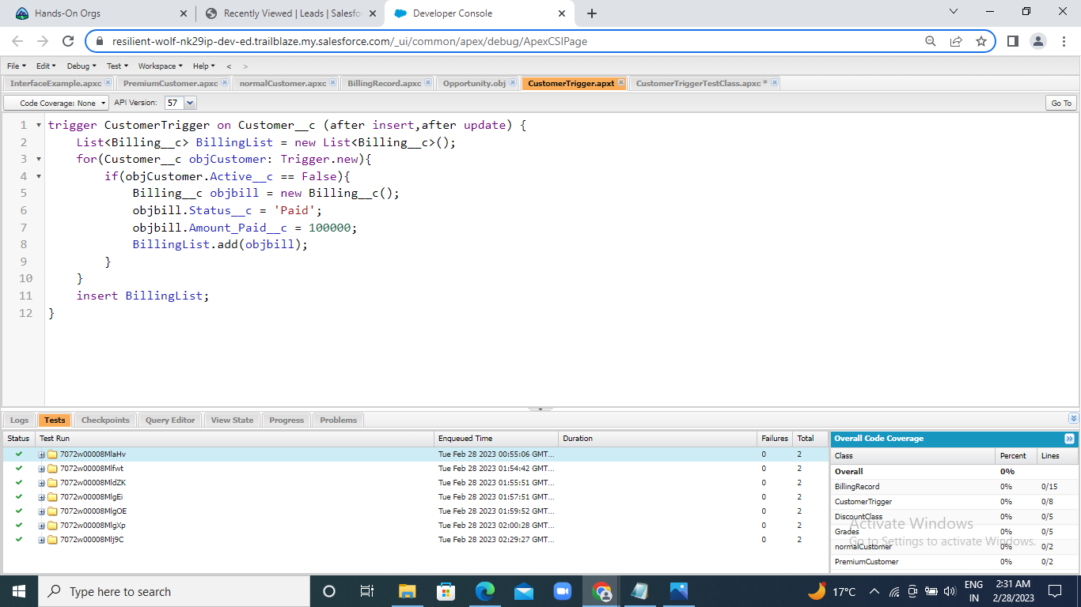
Exercise-12:

Slide 23
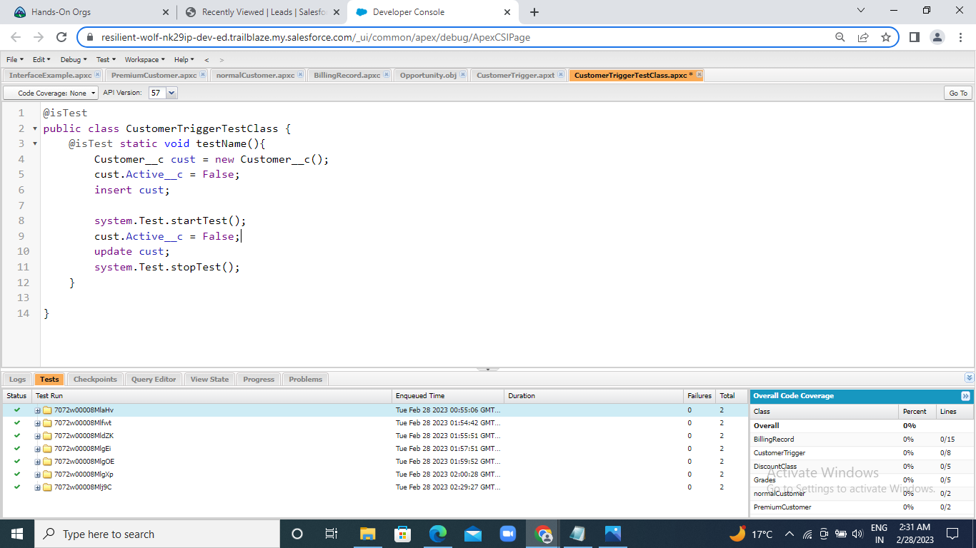
Exercise-13:

Slide 24
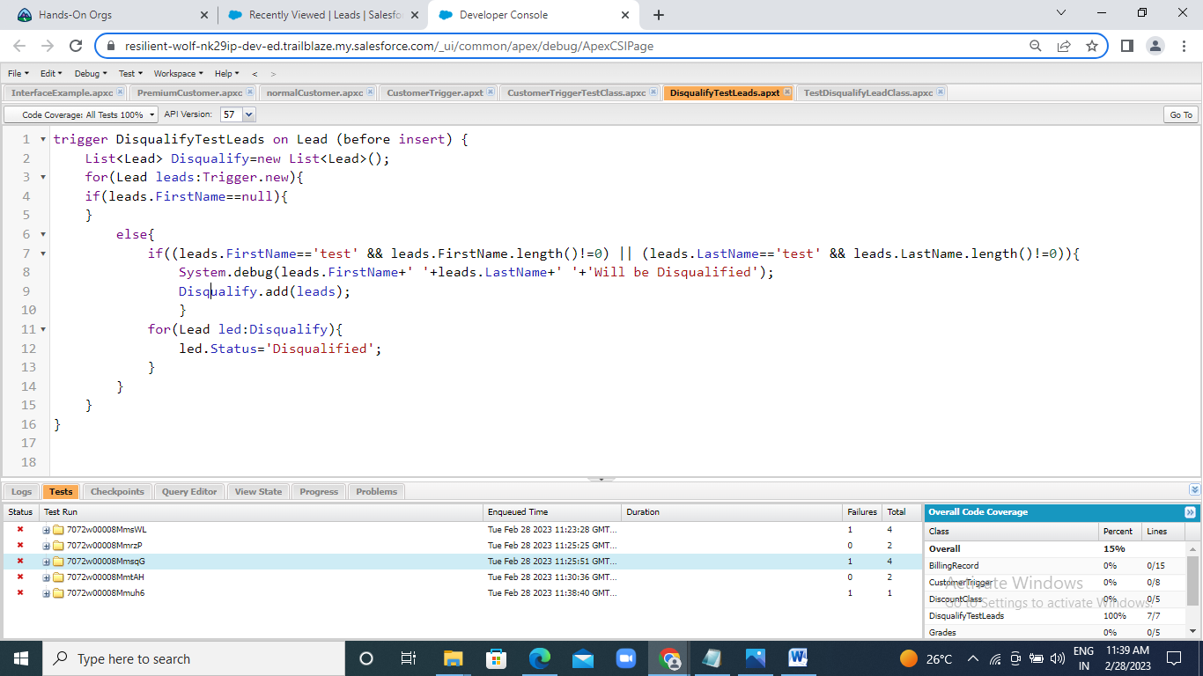
Exercise-14:

Slide 25
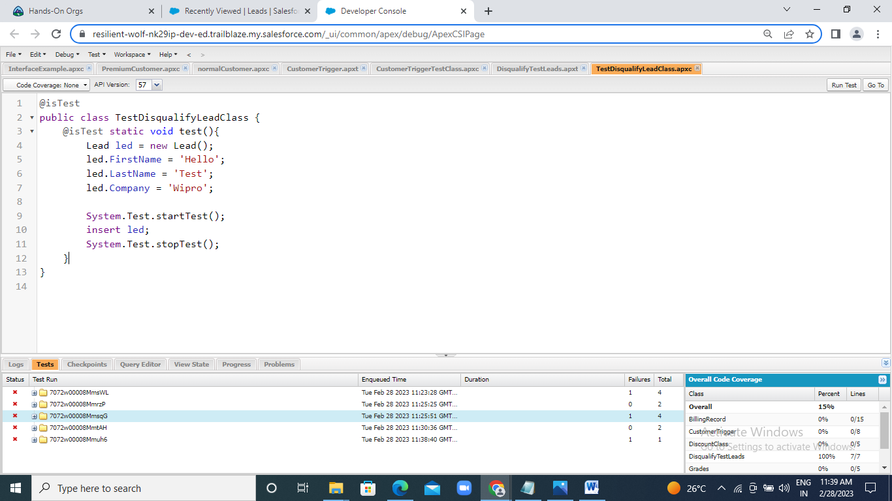
Exercise-15:

Slide 26
Thank You

